Slide 1

ICT 581 HTML5 and CSS3 with jQuery
Continuing Education
Day 9: React Testing
Mostafa Mohamed, PhD, P.Eng.
Adjunct Professor,
Electrical and Software Engineering Department
Mostafa.Mohamed@ucalgary.ca
@ 2022

Slide 2
Previous Class
Composition
React Design

Slide 3
Agenda
Convert React HTML to React Node.js Application
React Testing
Reading:
https://www.robinwieruch.de/react-testing-library/ Good tutorial
https://testing-library.com/docs/react-testing-library/example-intro Easy start
https://reactjs.org/docs/testing.html
https://jestjs.io/docs/getting-started

Slide 4
Convert React HTML to React Node.js Application

Slide 5
Converting React HTML to React Application
Create a new React App
e.g.: npx create-react-app weather-app
Copy all JS files to the new project inside src/components, rename the files if you want
Export all components from all file
e.g.: export default class Body extends React.Component{ … }
Import the required component in each file
e.g.: import Graph from "./graph";
Add a starting component to the app.js
Replace any third-party component with a NPM package (better to be made for React)
e.g.: Charts.js -> https://react-chartjs-2.js.org

Slide 6
React Testing

Slide 7
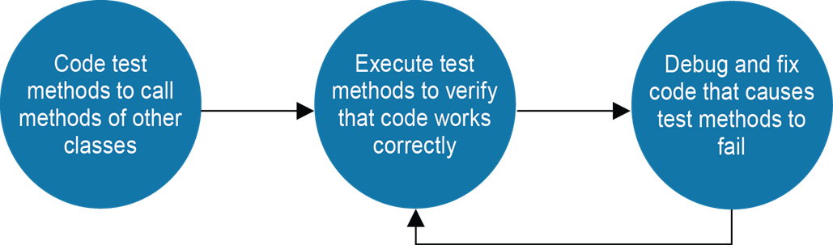
Introduction to Unit Testing
Unit testing helps you find problems earlier in the development cycle than would be possible if you tested all your methods manually.
You can run the unit tests for a class each time you change it to quickly detect any problems that were introduced.
You can develop and test an application more quickly because you don’t have to run the application and retest it each time you change the code. Instead, you can use unit tests to test just the code that was changed without running the application.
Unit testing makes debugging easier because when a test fails, you only need to debug the most recent code changes.
TDD – Test Driven Development –
first write tests, then code

Slide 8
Arrange-Act-Assert Test Structure
Arrange – initialize objects and data to be passed to the method under test
Act – invoke the method under test with the arranged parameters
Assert – verify that the method behaves as expected
How to create a Unit Test:

Slide 9
Jest
Jest is a JavaScript Testing Framework with a focus on simplicity.
It works with projects using: Babel, TypeScript, Node, React, Angular, Vue and more!
https://jestjs.io/docs/getting-started

Slide 10
Jest Code
describe('true is truthy and false is falsy', () => {
test('true is truthy', () => {
expect(true).toBe(true);
});
test('false is falsy', () => {
expect(false).toBe(false);
});
});

Slide 11
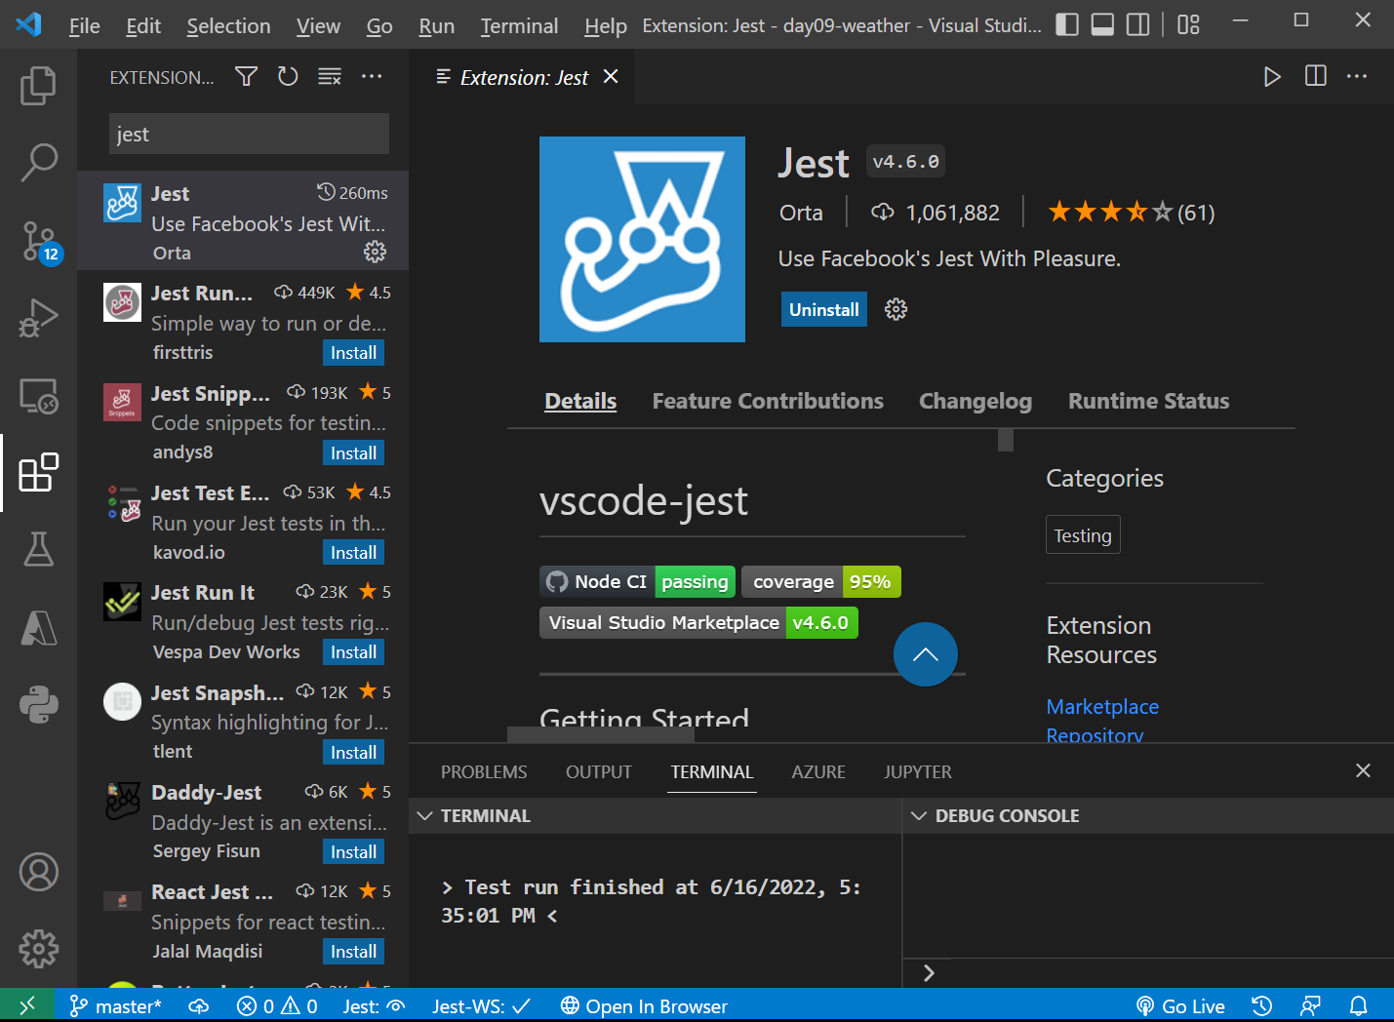
Install Jest VS Code Extention
Test extension for VS code makes testing more intuitive and easy.
https://developer.mozilla.org/en-US/docs/Web/API/UI_Events

Slide 12
React Testing Library
The React Testing Library is a very light-weight solution for testing React components. It provides light utility functions on top of react-dom and react-dom/test-utils, in a way that encourages better testing practices. Its primary guiding principle is:
The more your tests resemble the way your software is used, the more confidence they can give you.

Slide 13
Create a test
test('loads the weather item', async () => {
// Arrange --------------------------------
const data = {
dt: 45641621,
main: { temp: 20, feels_like: 22 },
wind: { speed: 10 }
}
// Act --------------------------------
render(<WeatherItem data={data} />)
// Assert --------------------------------
screen.debug() // Shows the rendered HTML as if it renders in Chrome
// Make sure it renders
expect(screen.getByTestId('11')).toBeInTheDocument()
// Make sure the Temperature is displayed with the correct value
expect(screen.getByTestId('11')).toHaveTextContent('Temperature 20C')
// Make sure the Feels like is displayed with the correct value
expect(screen.getByTestId('11')).toHaveTextContent('Feels Like 22C')
// Make sure the Wind Seed is displayed with the correct value
expect(screen.getByTestId('11')).toHaveTextContent('Wind Speed 10')
})

Slide 14
Activity

Slide 15
Create a Weather App with Tests
Covert the Weather HTML to Weather node application
Create a couple of tests
See:
weather-item.test.js
weather-item.test.js

Slide 17
Summary
Composition
React Design

Slide 18
Assignment 3
Task B:
Convert the Weather Application to React Node Application
Add 3 test files for 3 components
Each test file should have 2 tests

Slide 19
Thank you for attending today!!!
Mostafa Mohamed, PhD, P.Eng.
Mostafa.Mohamed@ucalgary.ca
WhatsApp: 403-966-8112

